Slide 1
527 Data Analytics
April 26th, 2016
Final Project: AmerisourceBergen - Group 8
-GGaurav Karoor
Dhruv Sethi Nashwin Thomas Allen Dsouza Raul Pinto

Slide 2
Outline
Introduction
About AmerisourceBergen
DEF 14A Form
Scope of the analysis
Analysis
Evolution of the CEO’s salary and bonus awards.
CEO’s total compensation vs stock price.
Stock Price evolution around the DEF 14A filing date.
KEIs Finding, pattern and top frequent word.
KEIs Finding.
Conclusion
2

Slide 3

Introduction
About AmerisourceBergen
AmerisourceBergen Corporation is an American drug wholesale company.
Formed in 2001 by Merger of Amerisource Health Corp. & Bergen Brunswig Corp.
They have 26 pharma Distribution centers in US and 9 in Canada.
They own over 1 million sq.ft of Packaging center production Capacity in US & UK.
21 % revenue increase from the previous year.
Total worth - 135.9 billion USD surpassing giants like Facebook, Google , Microsoft.

Slide 4
Introduction
What is a DEF 14A form?
A DEF 14A form is the filing with the Securities and Exchange Commission (SEC) that must be filed by or on behalf of a registrant when a shareholder vote is required.
This form includes information about the date, time and place of the meeting of security holders revocability of proxy; dissenter's right of appraisal; persons making the solicitation; direct or indirect interest of certain persons in matters to be acted upon; modification or exchange of securities; financial statements; voting procedures; and other details.
All DEF 14A forms are available on the web site : www.sec.gov

Slide 5
Introduction
Scope of Analysis
To analyze the available DEF 14A filings of the company over a period of time i.e 2007 to 2016.
To identify the trends with respect to the CEO salary, Stock Awards, Option Awards, and Stock Price changes before and after the filing.
To identify the trends in Q & A Term Document Matrix statistics.

Slide 6
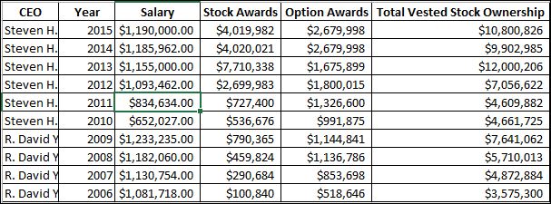
Analysis
10 year Executive Compensation table

Slide 7
Analysis Evolution of the CEO’s Salary.
Year 2010 saw the lowest CEO salary because a new CEO Steven H Collins was appointed that year replacing the David Yost who served the company for past 14 years

Slide 8
Analysis Stock & Option Awards

Slide 9
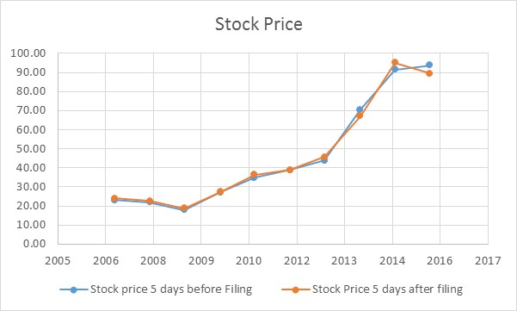
Analysis Stock Price evolution 5 days before & after DEF 14A filing
By observing the trend of the stock price just before and after the DEF 14A date we can conclude stock price is exponentially growing after each filing

Slide 10
Analysis Stock Price evolution 5 days before & after DEF 14A filing
Major Changes in the years
2008 - They identified their dead investments and unprofitable internal operations and shut those down facing major losses 2012-2014 – They started overselling a powerfull painkiller called Oxycodone into the markets and promoted its purchase without the need of any prescription.

Slide 11
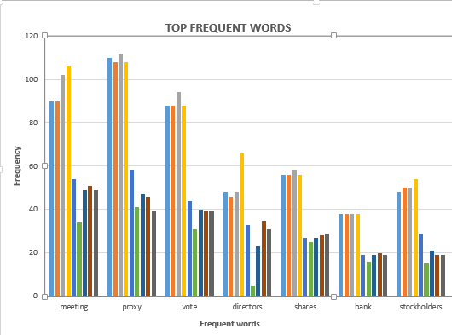
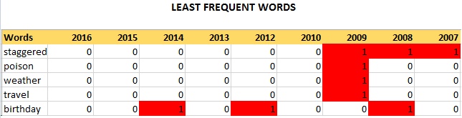
Analysis Word frequency.

Slide 12
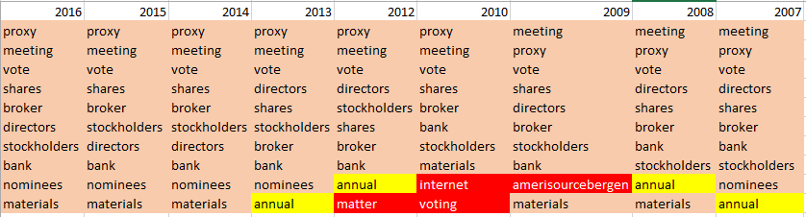
Analysis KEIs Findings, pattern and top frequent word.
Internet
Vote
Proxy
Meeting
Director
Shares
Internet
Important KEI’s
Staggered
Poison
Weather
Travel
Birthday

Slide 13
Analysis KEIs Findings, pattern and top frequent word.
Vote, Proxy, Meeting, Director, Shares: These words occur in all the DEF 14A a.k.a proxy statements filings because these are the one that define the purpose of the filings, For eg. Information about the voting procedure, important business discussions, companies background information and executive compensation tables, stock awards, salary are all documented in these filings. Internet: This is an important KEI because it occurs amongst the top frequent words for the year 2010. Further analysis reveals that in this year a new rule allowing internet voting was passed if a person could not be present physically for the meeting. Weather & Travelling : These are associated with the above Internet KEI in the year 2009. The reason behind this is, during that particular year many of the executives could not attend the meeting due to harsh weather. This led to the invention of the internet voting rule in the succeeding year Poison : This KEI occurred in 2009 because a new proposal was put forward, which gave the directors increased job security incase of declined stock prices and poor performance of the company.

Slide 14
Conclusion
AmerisourceBergen has grown into a powerhouse pharmaceutical company
From 2006 to 2016, it has seen two CEO’s change hands
Automated the Summary Executive Compensation information using R which provides valuable information on the company’s stock awards, bonus awards
Using text mining analysis, ‘internet’ was the most influential KEI as it was the very first time in 2010 where this technology was used in voting system
Today’s use of text mining in different fields Biomedical applications Security applications Marketing applications Online media applications Academic applications

